Slide 1
Plateau Mc Do U7 - U9
Samedi 21 Octobre 2023
AS PAPENOO

Slide 2



FOOTBALL
Lieu du Plateau | AS EXCELSIOR | AS CENTRAL | AS TAIARAPU FC | AS EXCELSIOR | AS CENTRAL | AS TAIARAPU FC
SAMEDI 19 NOVEMBRE | AS EXCELSIOR (1) | AS CENTRAL (1) | AS TAIARAPU FC (1) | AS EXCELSIOR (1) | AS CENTRAL (1) | AS TAIARAPU FC (1)
 | AS DRAGON (1) | AS MANU URA (1) | AS PUEU FC (1) | AS DRAGON (1) | AS MANU URA (1) | AS PUEU FC (1)
 | AS VENUS (1) | AS TEFANA (4) | AS PAPARA FC (1) | AS VENUS (1) | AS TEFANA (4) | AS PAPARA FC (1)
 | AS ARUE (1) | AS T.PUNARUU (1) | AS MATAIEA (1) | AS ARUE (1) | AS T.PUNARUU (1) | AS MATAIEA (1)
 | AS OL. MAHINA (1) | AS PIRAE (2) |  | AS OL. MAHINA (1) | AS PIRAE (2)
 | AS JT (1) |  |  | AS JT (1)
 | AS PAPENOO (2) |  |  | AS PAPENOO (2)
 | AS HITIA'A FC (1) |  |  | AS HITIA'A FC (1)
Organisation de la Journée
Les Equipes U7
U9
U7 | U9
AS Papenoo | AS Papenoo
AS Venus (4 équipes) | AS Venus (4 équipes)
AS Central (2 équipes) | AS Central (2 équipes)
8H30 / 10H30
3

Slide 3
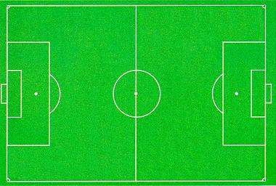
Zone et Terrain
Terrain extérieur
Atelier Educatif
Foot à 4 : 28 x 20 m | Foot à 4 : 28 x 20 m
Foot à 4 : 28 x 20 m | Foot à 4 : 28 x 20 m
Foot à 4 : 28 x 20 m | Foot à 4 : 28 x 20 m
Foot à 5 : 35 x 25 m
Foot à 5 : 35 x 25 m
Foot à 5 : 35 x 25 m
Foot à 5 : 35 x 25 m
Terrain extérieur
Atelier Educatif
Terrain U9
TerrainU7

Slide 4
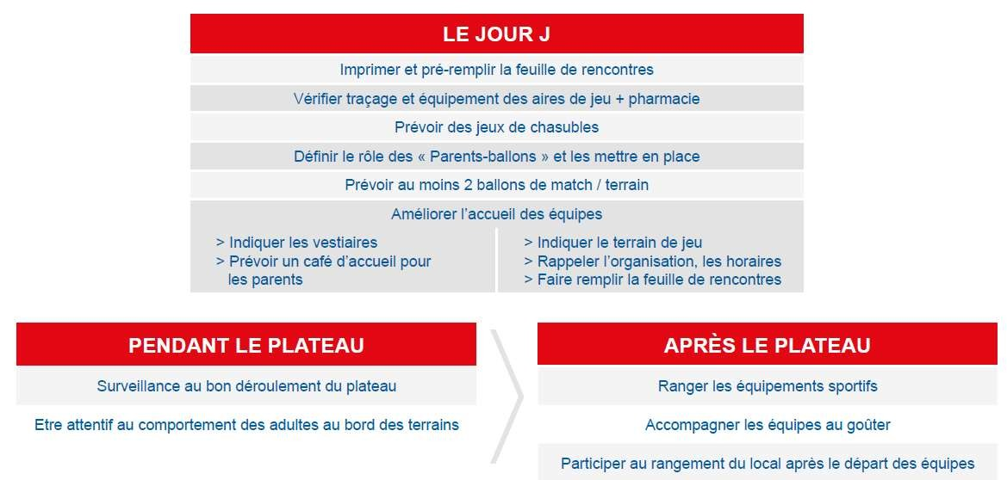

Déroulement Type d’un Plateau

Slide 5
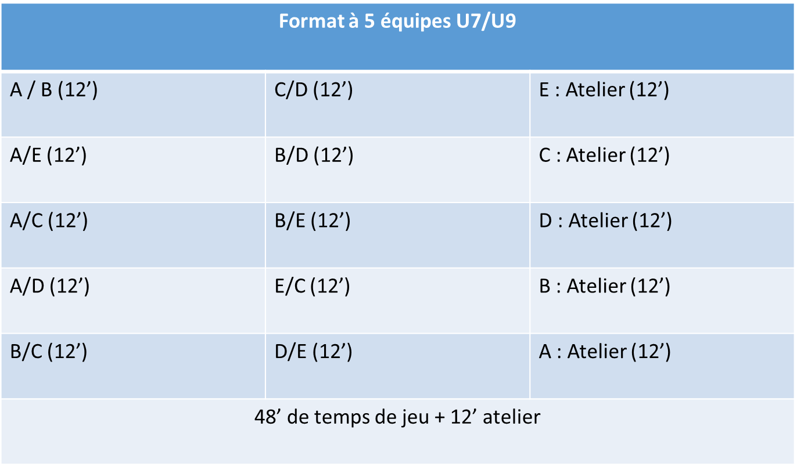
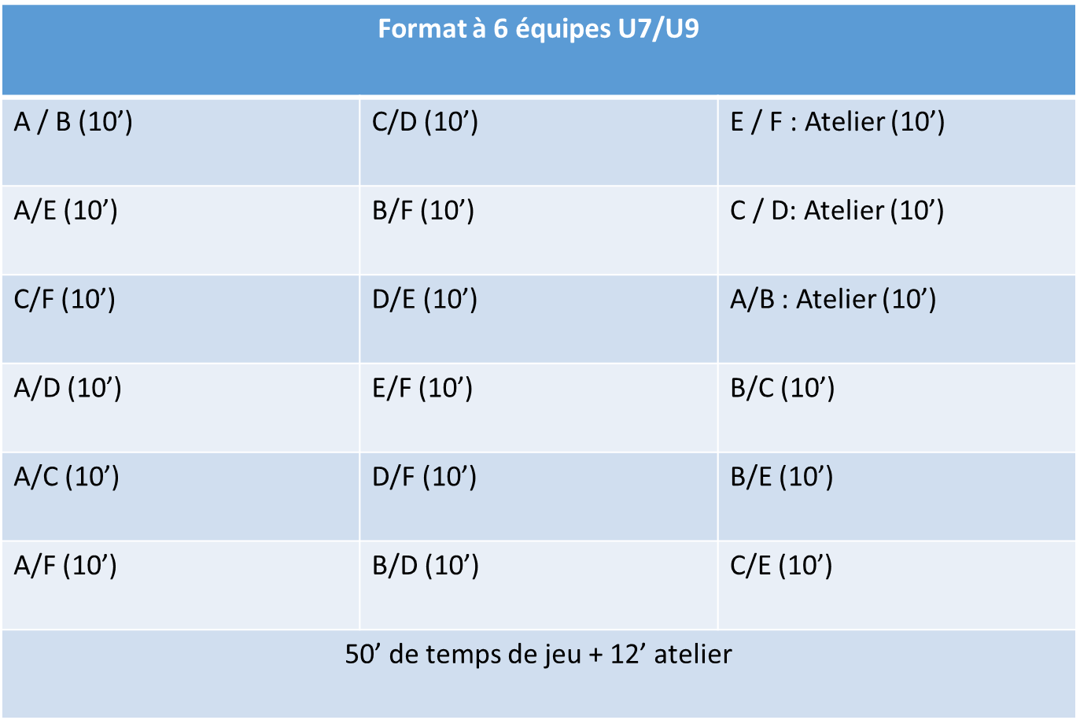
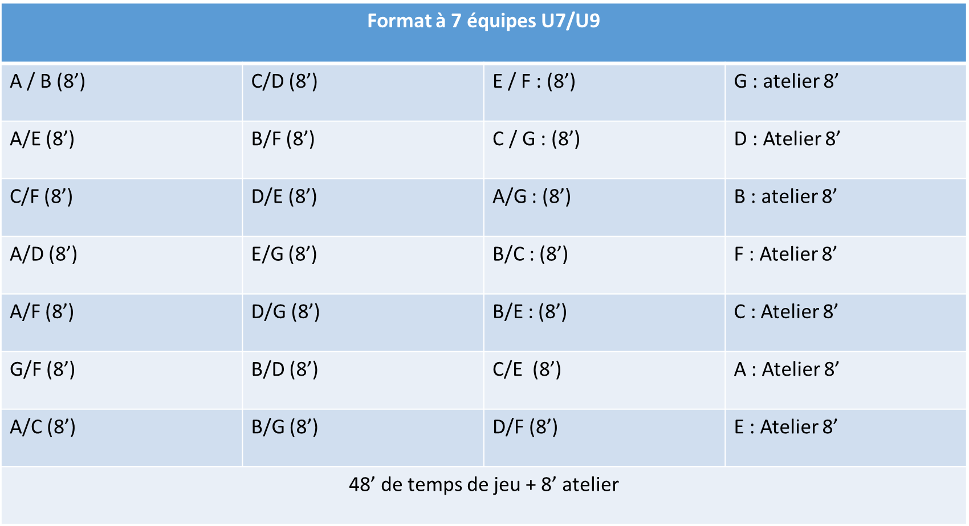
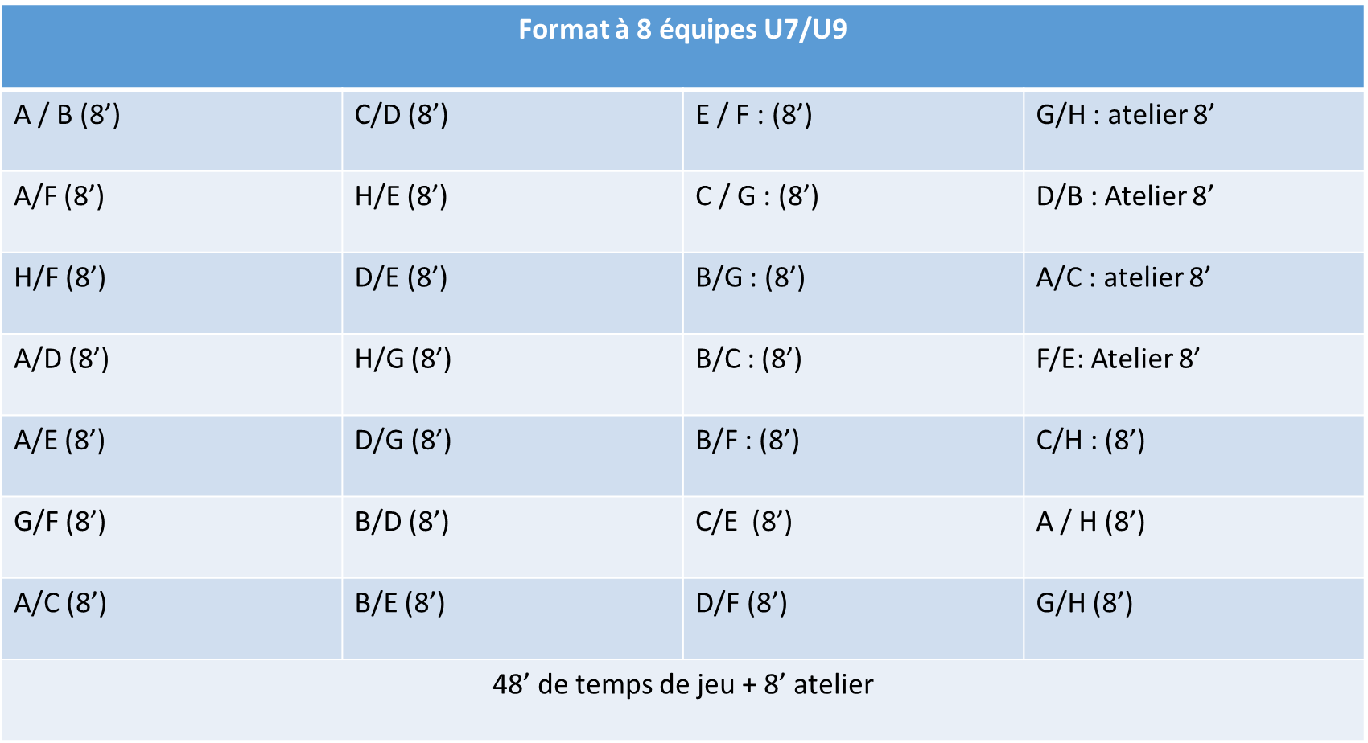
Les différents formats de plateaux

Slide 6
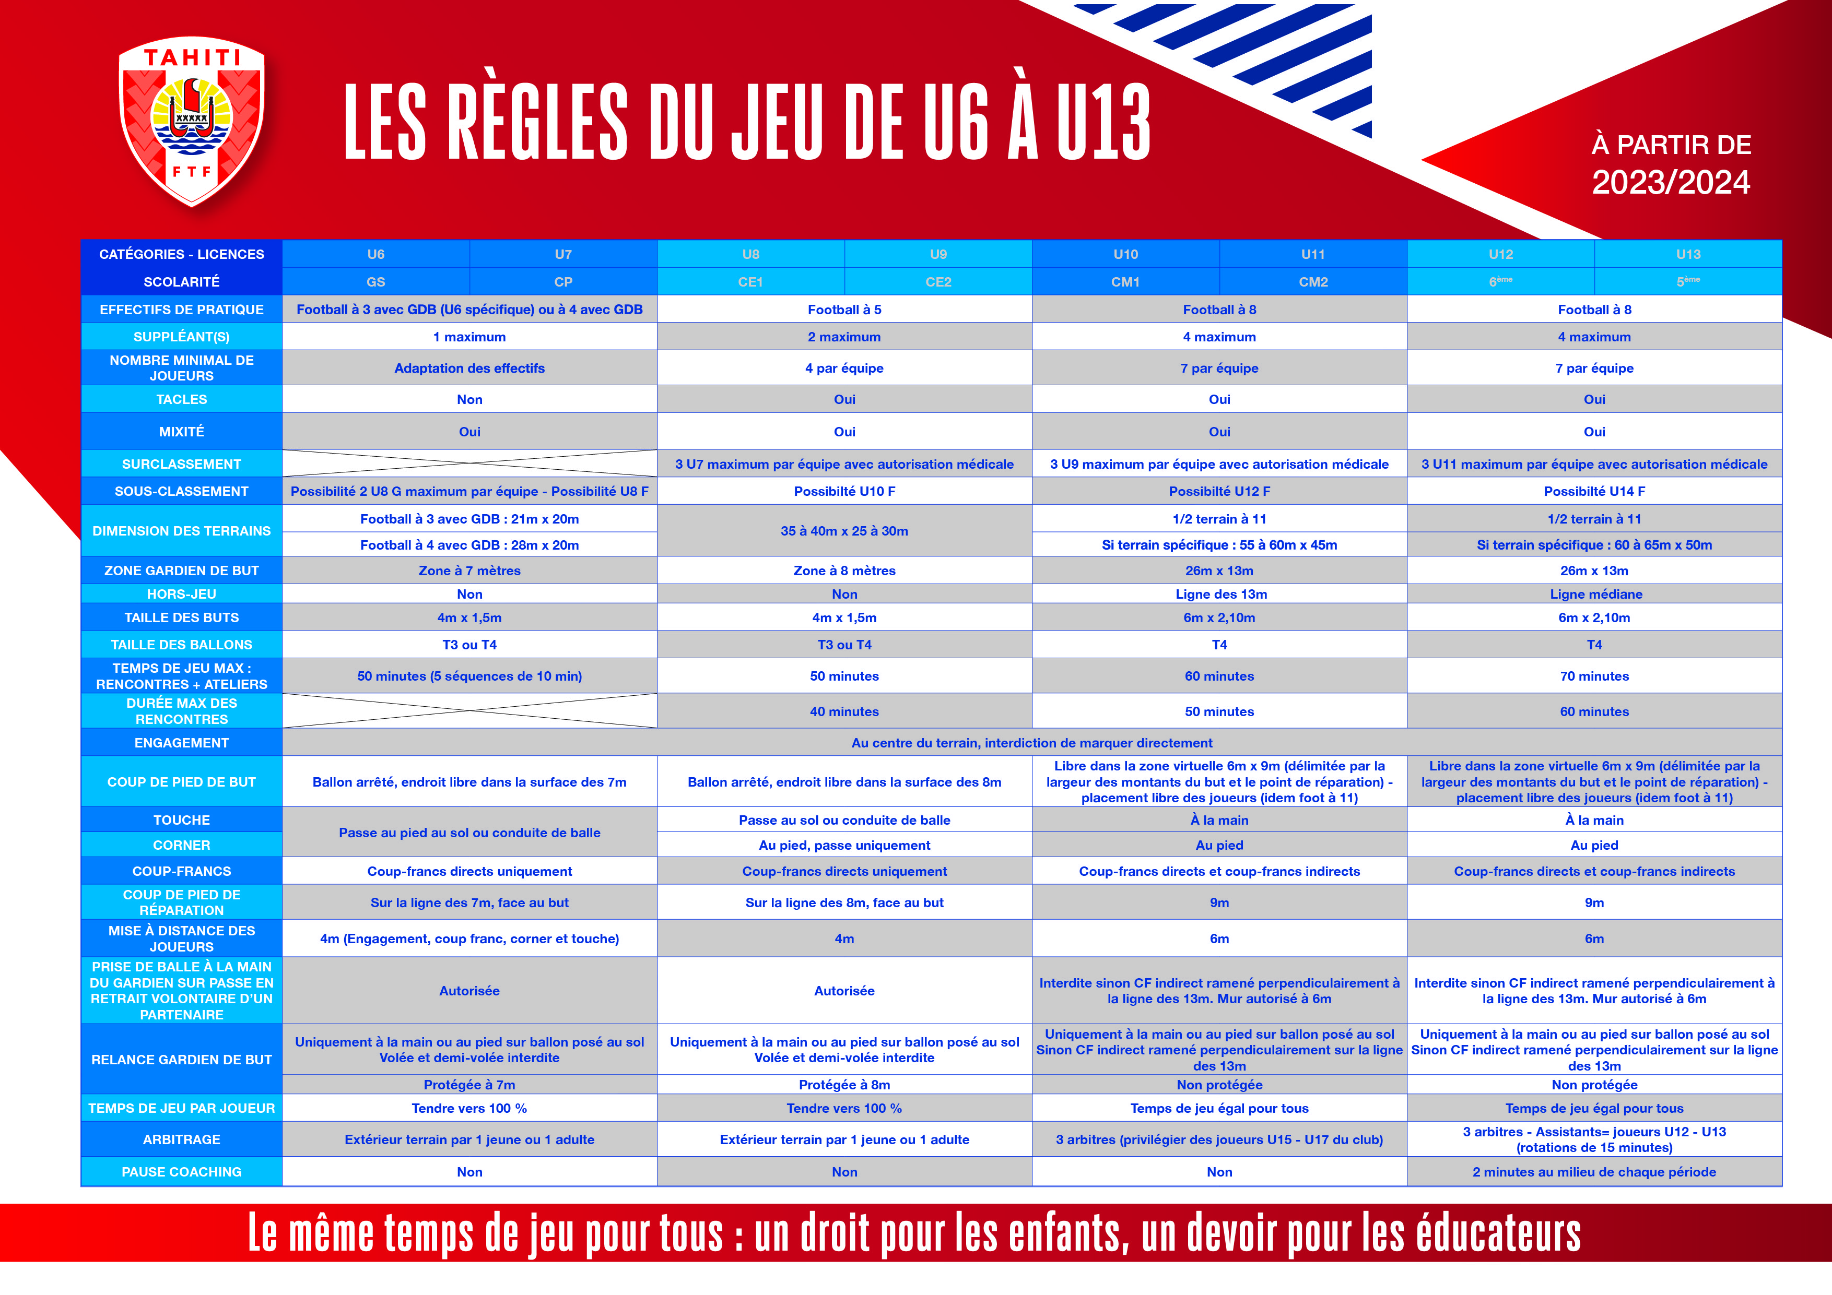

Slide 7
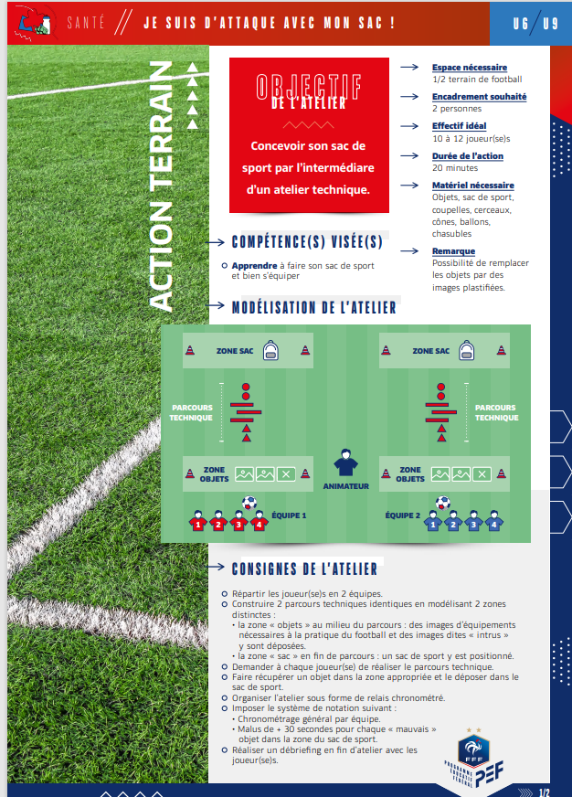
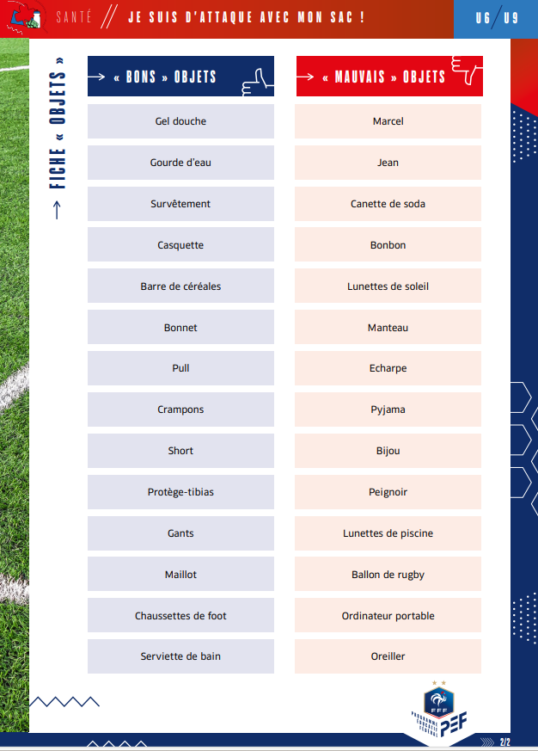
Atelier PEF

