Slide 1
Plateau Mc Do U11 – U13
Samedi 18 Mars 2023
Organisation AS T PUNARUU

Slide 2
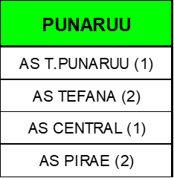



FOOTBALL
Lieu du Plateau | AS EXCELSIOR | AS CENTRAL | AS TAIARAPU FC | AS EXCELSIOR | AS CENTRAL | AS TAIARAPU FC
SAMEDI 19 NOVEMBRE | AS EXCELSIOR (1) | AS CENTRAL (1) | AS TAIARAPU FC (1) | AS EXCELSIOR (1) | AS CENTRAL (1) | AS TAIARAPU FC (1)
 | AS DRAGON (1) | AS MANU URA (1) | AS PUEU FC (1) | AS DRAGON (1) | AS MANU URA (1) | AS PUEU FC (1)
 | AS VENUS (1) | AS TEFANA (4) | AS PAPARA FC (1) | AS VENUS (1) | AS TEFANA (4) | AS PAPARA FC (1)
 | AS ARUE (1) | AS T.PUNARUU (1) | AS MATAIEA (1) | AS ARUE (1) | AS T.PUNARUU (1) | AS MATAIEA (1)
 | AS OL. MAHINA (1) | AS PIRAE (2) |  | AS OL. MAHINA (1) | AS PIRAE (2)
 | AS JT (1) |  |  | AS JT (1)
 | AS PAPENOO (2) |  |  | AS PAPENOO (2)
 | AS HITIA'A FC (1) |  |  | AS HITIA'A FC (1)
Organisation de la Journée
Les Equipes U11
U13
U11
U13
A
B/C
D
E/F
A
B/C
D
E/F
8H30 / 10h30 10H30 / 12H30
3

Slide 3
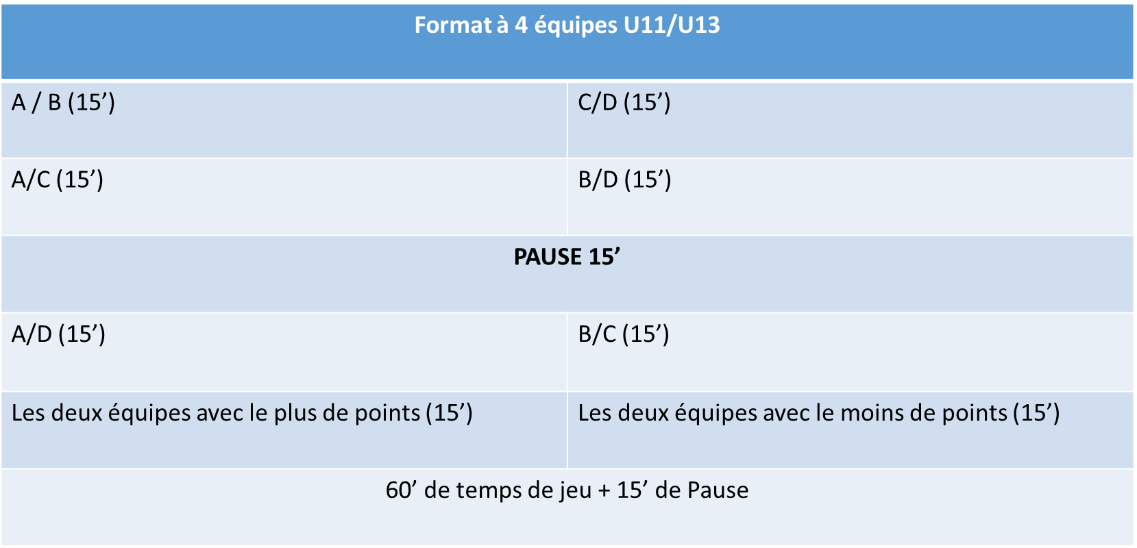
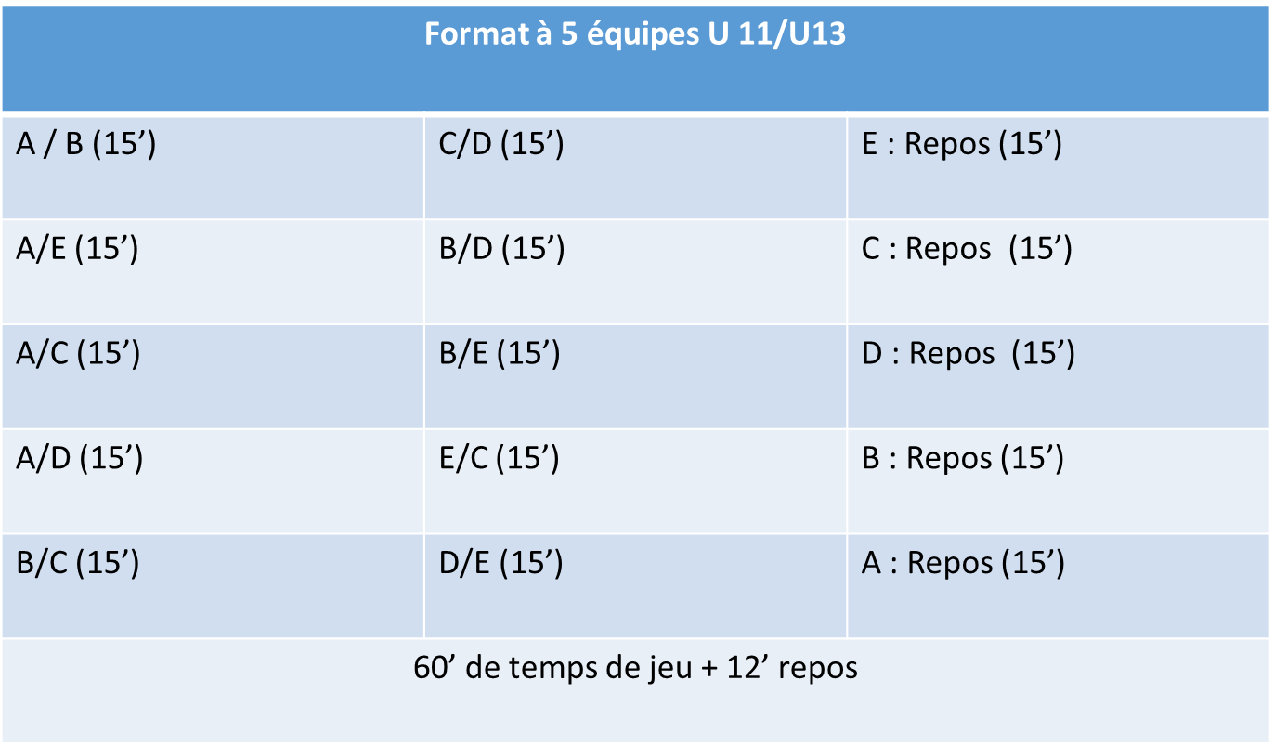
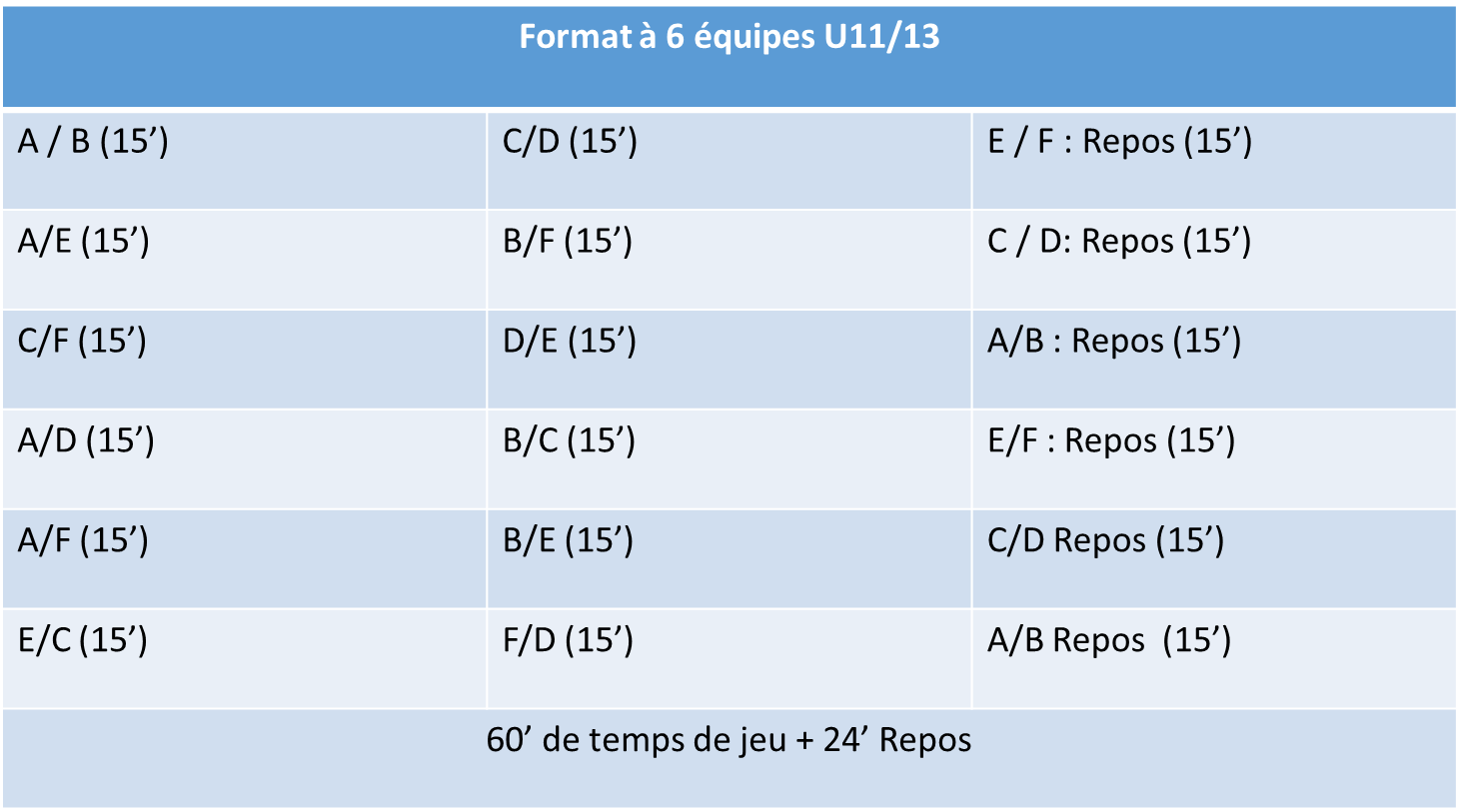
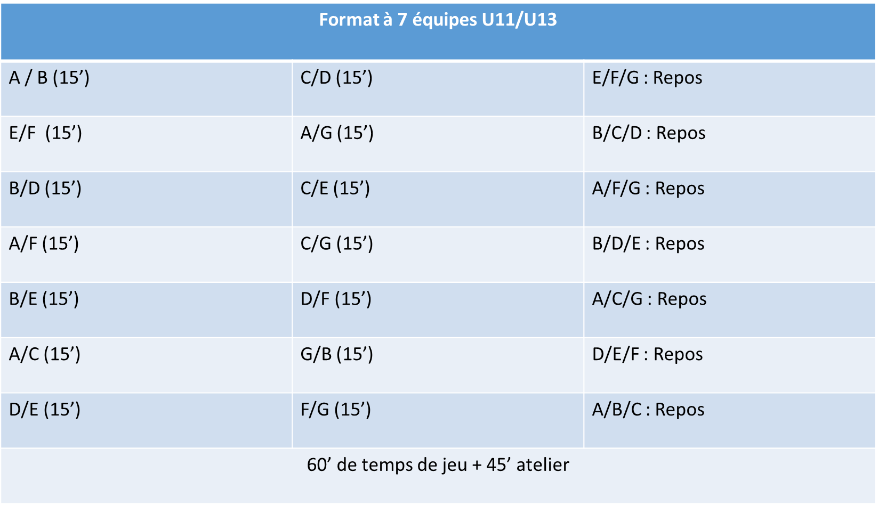
Les préconisations de Format pour un temps de jeu suffisant
La Lettre correspond à celle en face de votre club diapo précédente

Slide 4
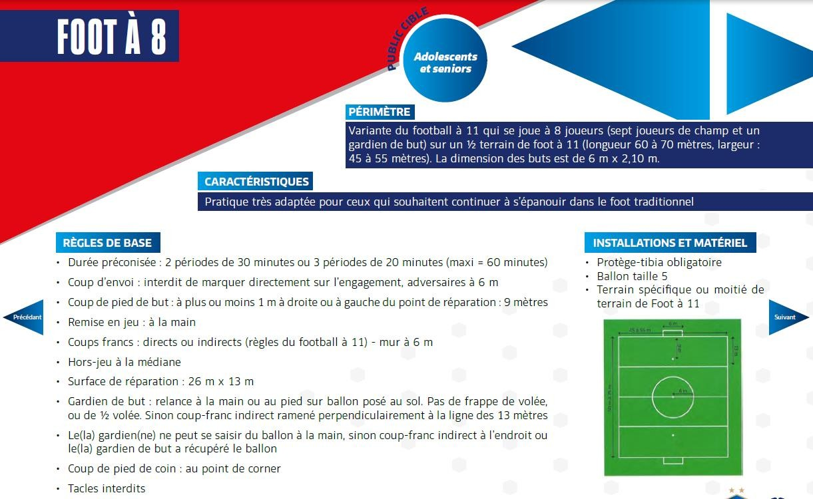
10

Slide 5
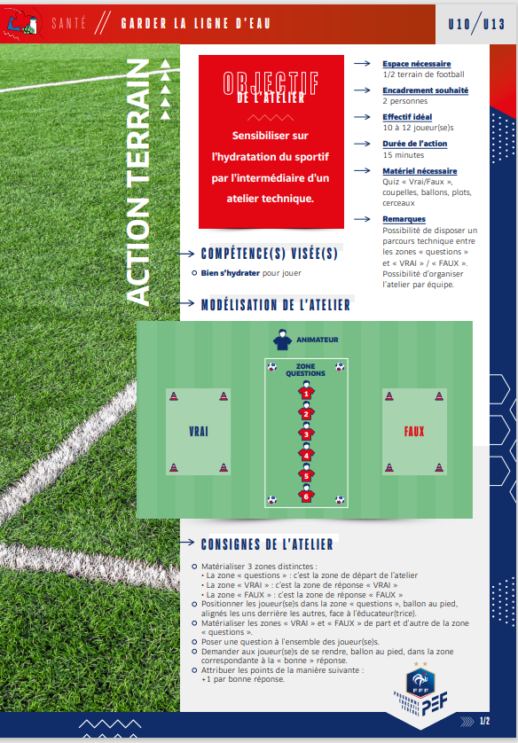
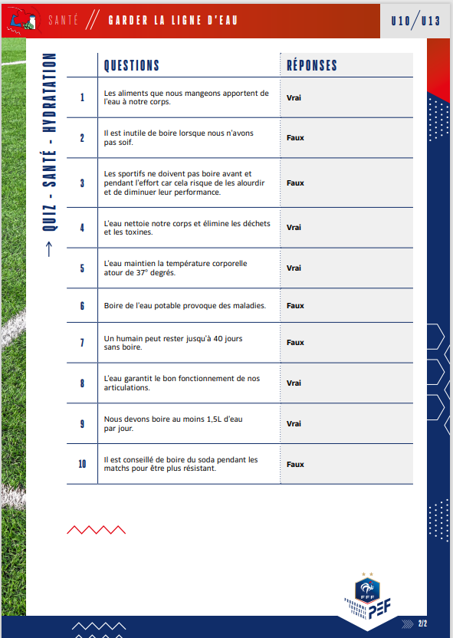
Atelier Educatif

Slide 6
Informations complémentaires
Les feuilles de matchs sont à retourner à la FTF à l’adresse mail suivante : yohan.tristant@ftf.pf avant mardi 12H de la semaine qui suit le festival
Obligation de présenter ses licences au club recevant à votre arrivée sur le festival
Protèges Tibias obligatoires !
Respect du temps de jeu par équipes et par joueurs !

